Slide 1
SOFT252 PatientManageMentSystem User Guide
Reece Davies [10572794]

Slide 2
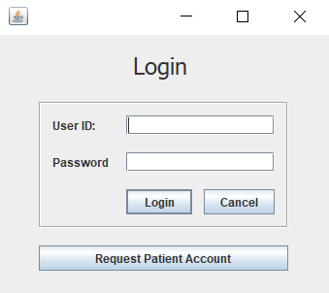
Login
A1000
Password
P1000
Password
D1000
Password
S1000
Password
User inputs the account id and password. They all have default password: “Password”

Slide 3
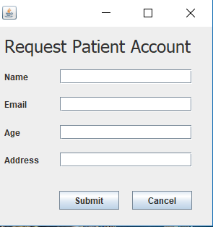
Request account
User is able to request a patient account through this form. Can be accessed from login form

Slide 4
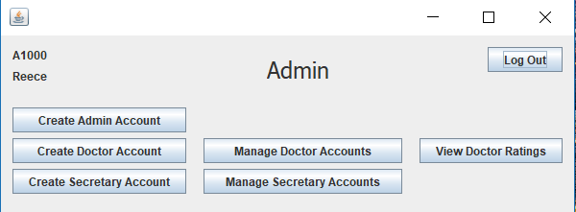
Admin navigation
Once logged into Admin, this form shows all relevant navigation

Slide 5
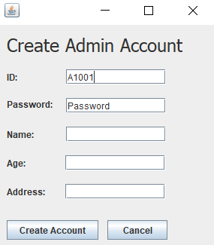
Create admin
Allows to create an admin account

Slide 6
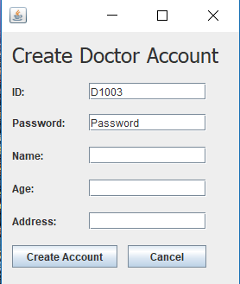
Create doctor account
Allows to create a doctor account

Slide 7
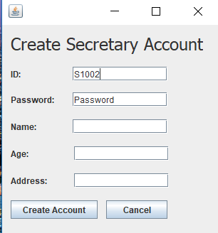
Create secretary account
Allows to create a secretary account

Slide 8
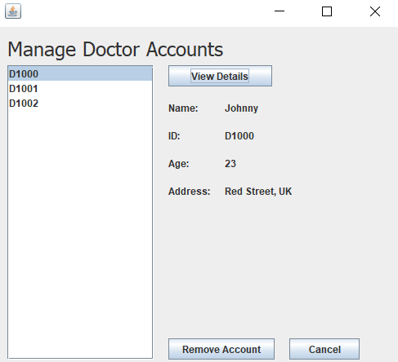
Manage doctors
Used to view doctor details and remove the account

Slide 9

Manage secretaries
Used to view secretary details and remove the account

Slide 10
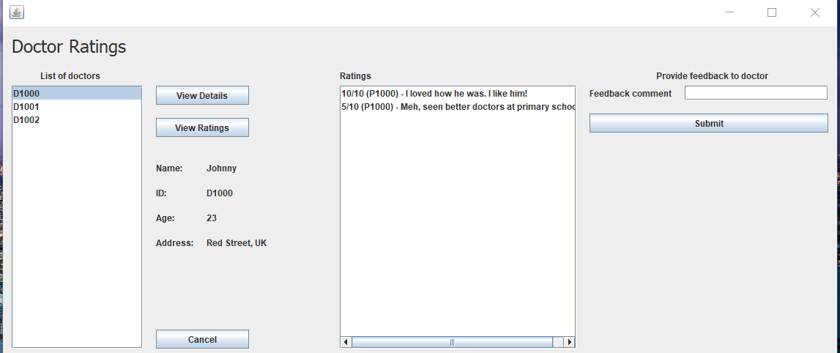
Doctor ratings
Shows doctor rating, and can offer feedback to specific doctor.

Slide 11
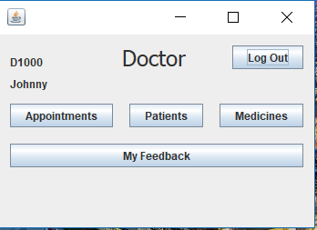
Doctor navigation
Once logged into Doctor, this form shows all relevant navigation

Slide 12
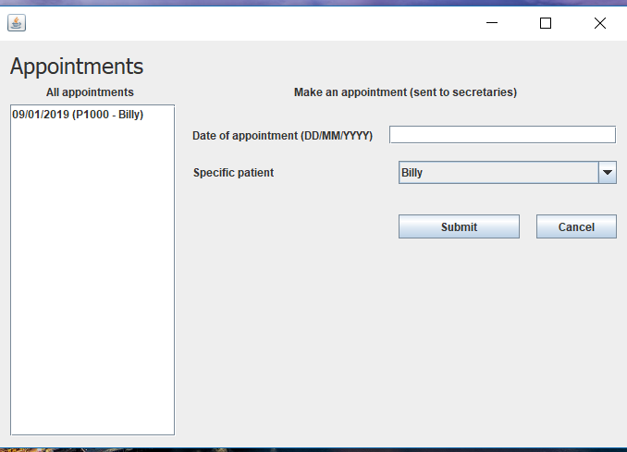
Appointments
Shows the appointments that the doctor has

Slide 13
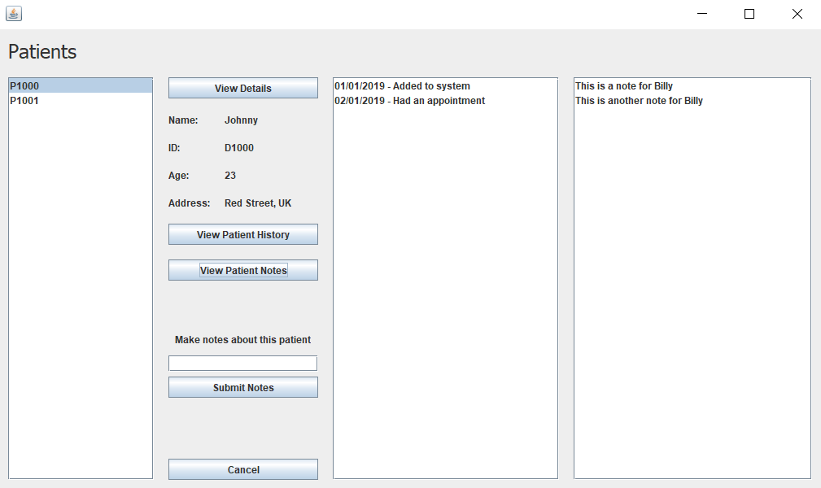
View patients
Allows doctor to view patients details and history

Slide 14
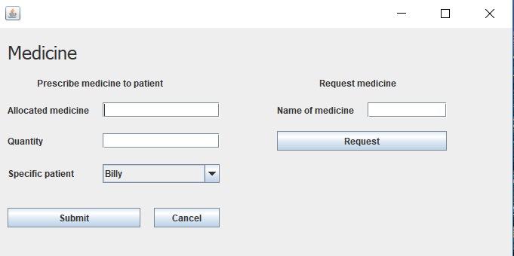
Manage medicine
Allows doctor to prescribe medicine to patient, and request secretaries to order more of a specified medicine

Slide 15
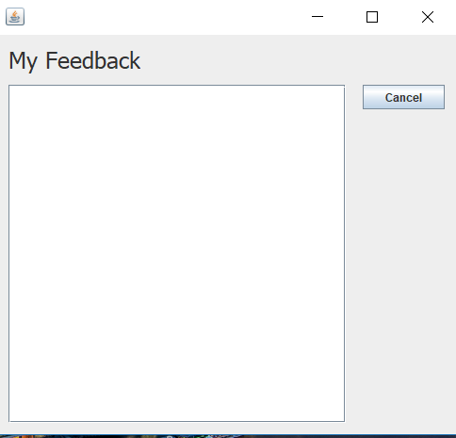
Feedback
Shows doctor’s feedback

Slide 16
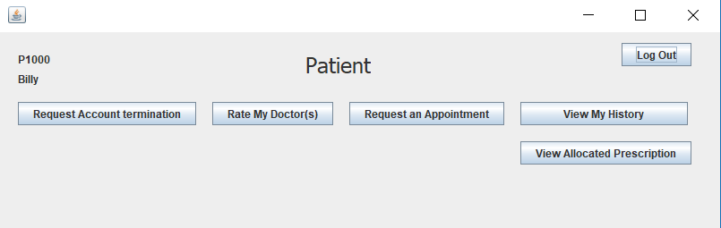
Patient navigation
Once logged into Patient, this form shows all relevant navigation

Slide 17
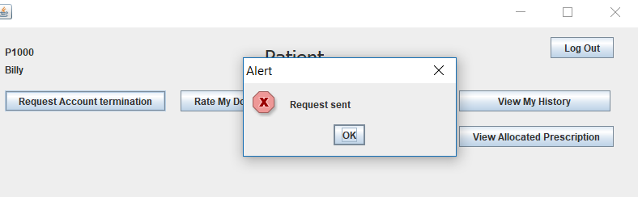
Request account termination
Sends request to secretaries for account termination

Slide 18
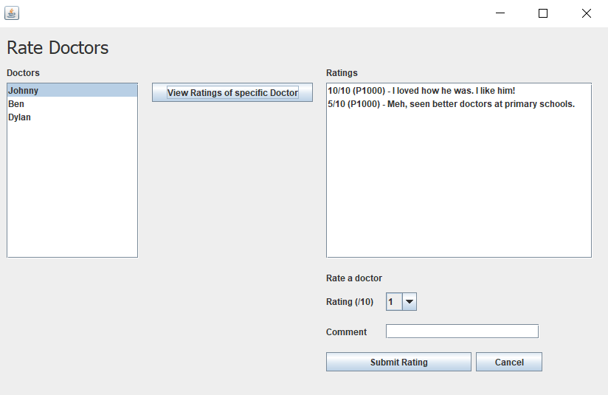
Rate doctors
Allows patient to rate specified doctors out of 10, and with comment

Slide 19
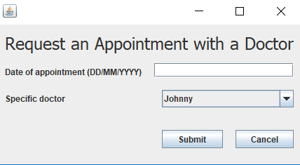
Request appointment
Patient can request an appointment with a specified doctor

Slide 20
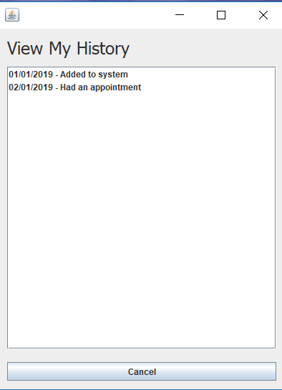
History
Displays patient history on list

Slide 21
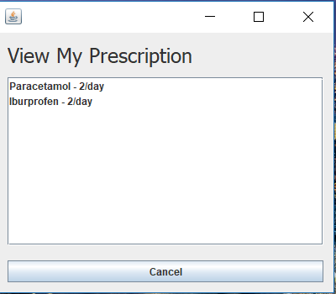
Prescription
Displays patient prescription on list

Slide 22
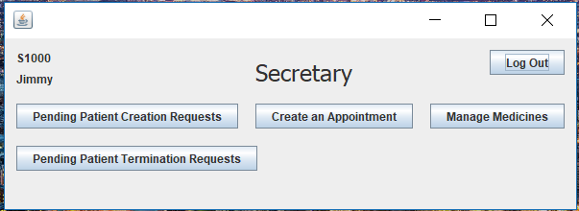
Secretary navigation
Once logged into Secretary, this form shows all relevant navigation

Slide 23
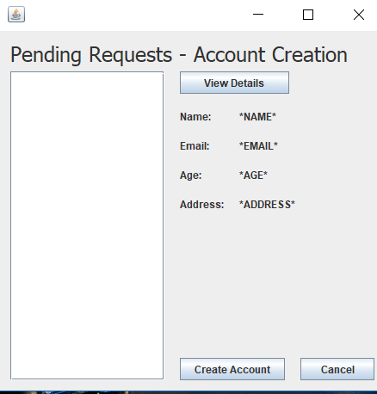
Account creation requests
Shows requests for patient account creation

Slide 24
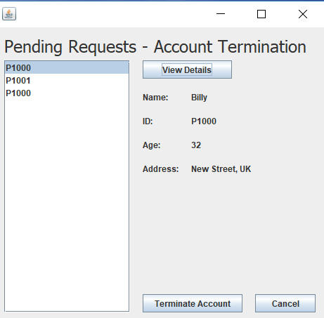
Account termination requests
Shows requests for patient account termination

Slide 25
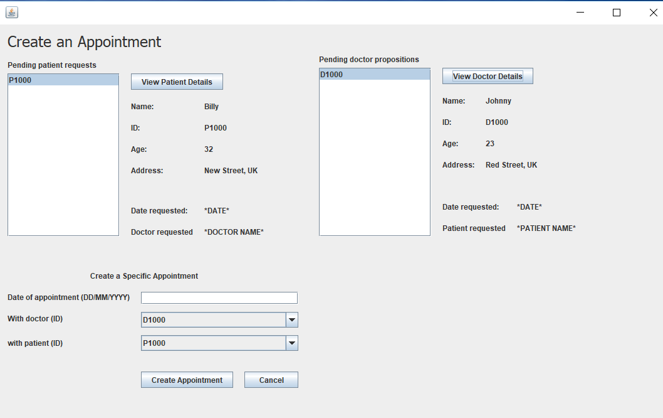
Create appointment
Secretary can view appointment requests (from patients) and propositions (from doctors), and create them with specific doctor and patient.

Slide 26
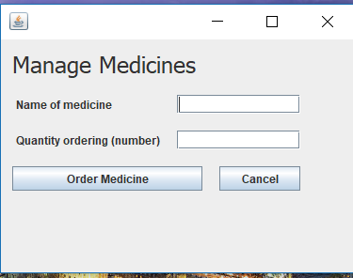
Manage medicines
Allows secretary to order new medicines

